Slide 1
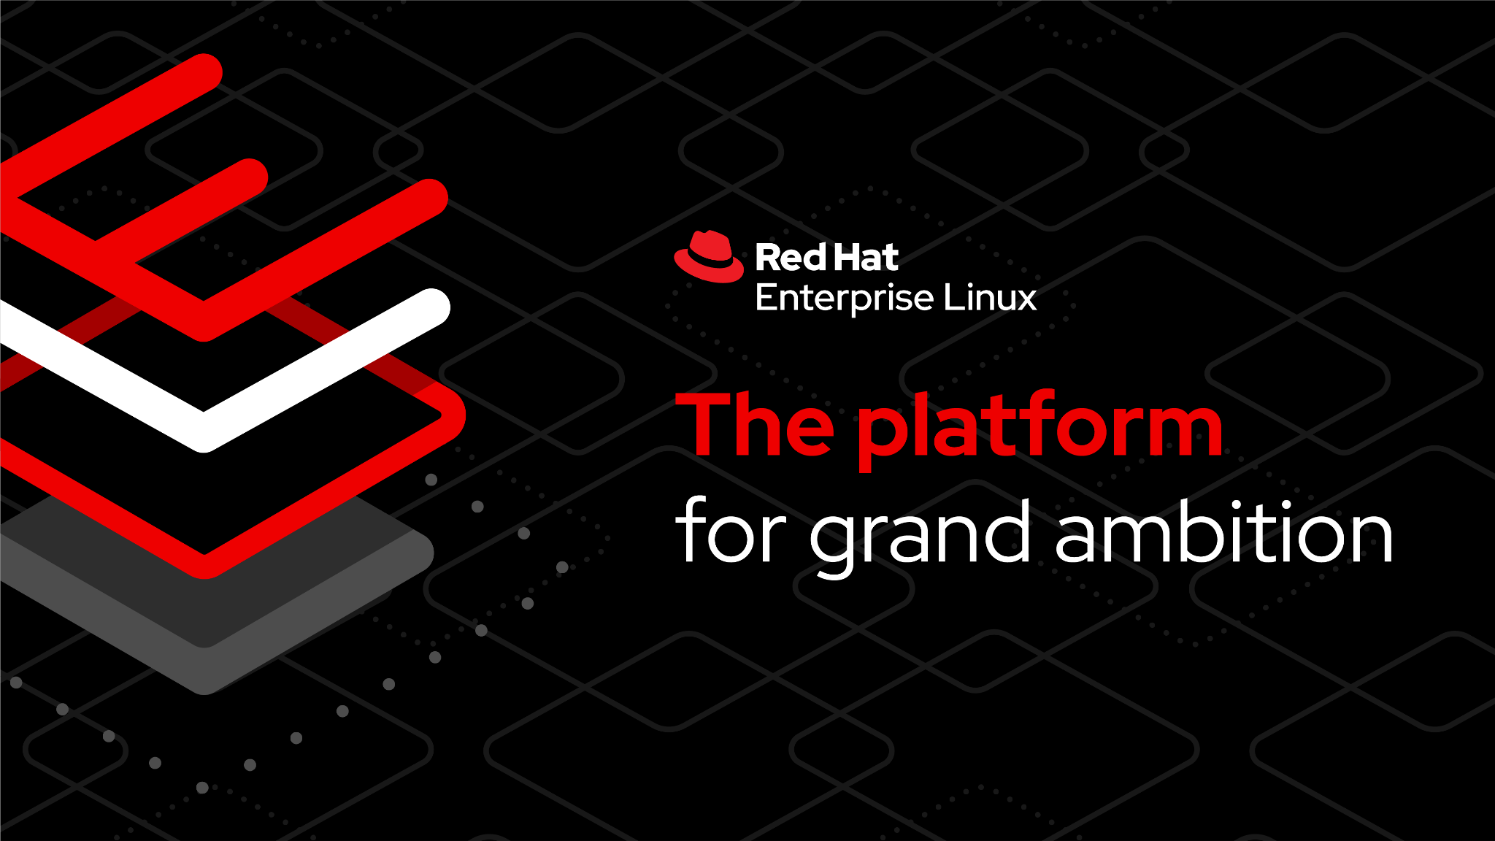

Slide 2
Our journey
Red Hat Infrastructure Standard
Adoption Model
Notes:
Storify

Slide 3

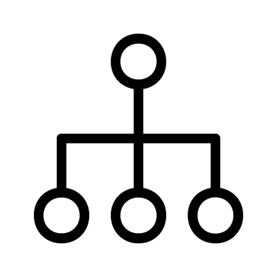









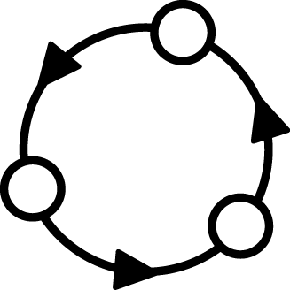
Adopt Red Hat Infrastructure the right way!
Red Hat Infrastructure Standard Adoption Model
Standardise intelligently and automate to enable responsive IT
Fragmented ‘approach’ |  | Snowflakes Tool-du-jour Manual, error-prone | Documentation gaps Tribal knowledge Silos of expertise | Legacy deployments Technical debt Static images
Standard Operating Environment
Standardize
Automate
Iterate
Notes:
[Content Owner]: Paul Armstrong
Linux Adoption is no different than any other operating system. It starts with 1 admin deploying 1 server and figuring out how it is supposed to work. Then a second system is created and connect them on a network. Now they have to figure out all the things that make systems talk and play nice with each other on a network.
Authentication, Name Services, Time Services, etc.. all the things that are there before we even think about putting an application on a system.
Then we have to keep it up to date as we work with it, back it up, configure it.
All this is pretty simple with 2 machines and not very labour intensive.
What happens when we get to 10? 100? 1000?
Each team can take their own approach to these challenges. Then when they come together, we get standards that, well, aren’t so standard.
So, we need standardization before we can automate.
It's not done, because it's never perfect. Perfect is the enemy of Good.
So we Iterate. What does this start to look like… What are some of our blockers..

Slide 4

Standard Infrastructure Deployment
Red Hat Infrastructure Standard Adoption Model
What, how, and why
 | Challenge |  | Approach |  | Benefits
Fragility
Systems are specified and built with inflexible scripts and/or complex procedures that make reuse and revision difficult
Refactor
Redefine systems in functional layers and reusable elements for a component-based approach to Standard Operating Environment
Flexibility
Update components independently and recombine easily to streamline SOE definition and maintenance
Variability
New patches, updates, and configurations are applied piecemeal across the environment multiplying inconsistencies
Standardize
Codify content delivery, configuration, and lifecycle management with tooling and monitoring
Efficiency
Easily monitor and manage drift, versioning, and compliance with system-wide or individual remediation
Complexity
Manual processes and complex scripts lead to errors in production that are hard to isolate and resolve.
Automate
Specify system build and configuration in human readable language and validate delivery in lab environments.
Reliability
Rapid and repeatable provisioning of proven production systems, in isolation or en mass, with trusted automation
Notes:
[Content Owner]: Paul Armstrong
One of the concepts that we will discuss in that of the Standard Operating Environment. In a nutshell, it encompasses the content that we allow on our Linux systems, but it also helps us define how and when it gets there. One of the challenges that we at Red Hat see in many customers is that the way in which systems are spec’d out and built is so customized, that it is essentially a monolith. Once it is built, ongoing maintenance, revision and reuse are next to impossible. Also, different parts of the organization may have implemented different standards, or generated exceptions to meet deadlines, etc.. If we take the time to redefine the systems in terms of the functional layers of the software stack we can drive out the necessary components. The refactoring will revive the flexibility in our environment, allowing more easy recombination and streamlining maintenance.
As we refactor the components of the Operating Environment, we can drive standardization by codifying content delivery, configuration, lifecycle and compliance through tooling. These new standards in turn will drive efficiencies that in time will become positive feedback loops.
We need to show both the process and the architecture… the process is our consulting methodology and agile process and our architectures are tested in the field with some of our largest and most valued customers.
People -> Innovation Lab will train them…

Slide 5
A Standard Operating Environment
Red Hat Infrastructure Standard Adoption Model
What is a Standard Operating Environment and how will developing one benefit my business
Notes:
[Content Owner]: Paul Armstrong

Slide 6
What is a Standard Operating Environment?
Red Hat Infrastructure Standard Adoption Model
The model for the conditions under which we control our machines, systems and processes.
Value is created when we can refactor to a short, discrete list of SOEs using select tools designed to work together in well-defined processes, providing a path to integrated Automation.
A primary goal of the RH-ISAM project is to describe the components used in, and provide automation for, delivering infrastructure to ease and codify the building and maintaining of SOEs for Red Hat Enterprise Linux environments.
Notes:
[Content Owner]: Paul Armstrong
Break it down - the Oxford Dictionary defines these terms:
Standard - a model or norm for comparative evaluation
Operating - the control of the functioning of a machine, system, or process
Environment - the conditions under which an entity (machine, system, process) operates
We can have as many Standard Operating Environments as there are machines, systems, and processes. The value comes when we refactor these models so that we can start from a short discrete list of SOEs and well defined tools and processes that allow us to automate delivery.

Slide 7
But Why an SOE?
Red Hat Infrastructure Standard Adoption Model
What Hyperscalers do isn’t magic.
Efficiency
Simplified Onboarding and Support
Enhanced Compliance and Security
Healthy Patterns sustain Automation
Standardization simplifies and streamlines delivery and operations.
Standardization reduces volume of documentation, special procedures, and allows easier drift detection.
Infrastructure operations become more responsive as a result
Standardization reduces silos, tribal knowledge and allows for deeper knowledge to develop in teams
Standardization helps new-hires get to day2 faster
Operations and Helpdesk throughput increases
Standardization allows for faster anomaly detection. Configuration, behaviour and logging exceptions outside the norm are more easily spotted.
Standardization helps teams move beyond the checkbox and deliver on cybersecurity maturity
Standardization is a precursor to sustainable automation.
Delivering on proven design patterns allows for the extension of automation process beyond simple configuration and extend to systems generation and event driven response
These are only a few of the benefits organizations realize… also, easier development, rapid solution delivery, stability, etc..
Notes:
[Content Owner]: Paul Armstrong
When dev ops models are discussed they tend to focus a lot on the developer side of the model. The standard operating environment is critical for all those elements that run on top. Developer build systems, orchestration systems, production system creation and testing – all the elements that create the environment on which a devops model runs.
Each Standard Operating Environment model has a set of conditions that include: System content that is required / allowed, system configuration that is required, security configuration, deployment processes, application or runtime configuration, management processes, maintenance process/workflows, monitoring, logging, reporting, revision/recycling/retirement, etc..

Slide 8
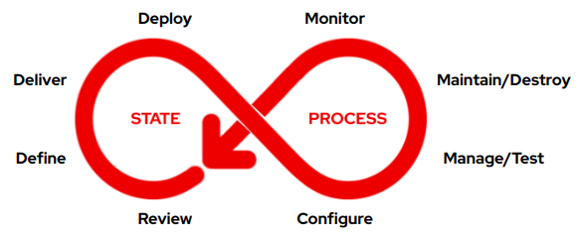
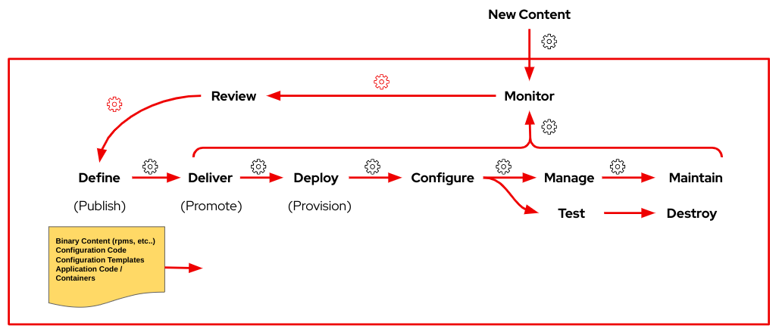
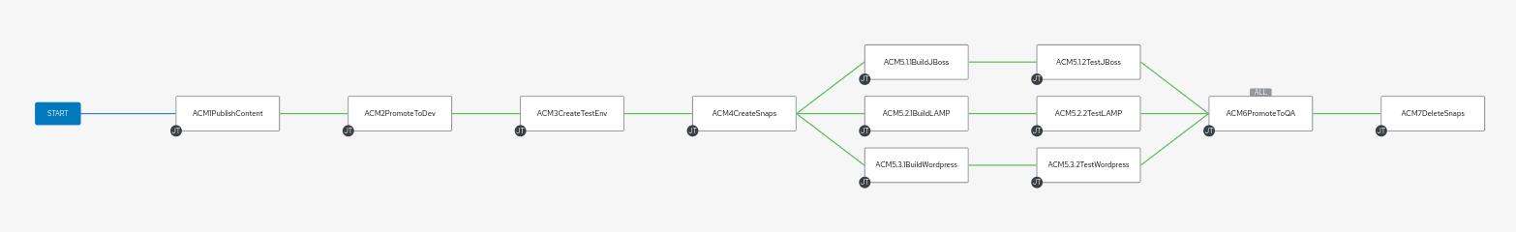
Red Hat Infrastructure Standard Adoption Model
From Concept…
To Model…
To Pipeline…
Notes:
[Content Owner]: Paul Armstrong, Mike Savage

Slide 9
Where does the RH-ISAM fit in the Strategy?
Red Hat Infrastructure Standard Adoption Model
How does the Red Hat Infrastructure Standard Adoption Model relate to strategic programs that Red Hat engages with their customers in?
Notes:
Storify

Slide 10
Capability Matrix for Flight Path
Red Hat Infrastructure Standard Adoption Model
Inflection Point
Platform Prep
Platform Delivery
Overall maturity increases up and to the right Copy this slide and use the colour fill key below to generate your map.
CI Framework
RH-ISAM
Observability Pub/Sub
Security Services Provisioning
Platform Workflow
Declarative Infrastructure
Operator Certification
Chargebacks
Automated Governance
Network Provisioning
Runbook Automation
Platform Security
Sidecar Integration
Resiliency Validation
Application Lifecycle Automation
Platform Bill of Materials
Storage Provisioning
Provisioning Mgmt
Prod-like Sandbox
Secrets Management
Build Pipelines
Disaster Recovery / Active Failover
FinOps
Software Bill of Materials
Compute Provisioning
Version Control
Single Containers
Storage/Network integration
Deployment Integration
Fleet Management
Zero Trust
Custom Policy Enforcement
Config Mgmt
Automation Workflow
Dev Workstations
Workload Analysis
Image Ingestion
SRE Patterns
Service Mesh
Reg. Auditing & Reporting
Foundational Automation
Infrastructure Automation
Container Development
Container Platform Essentials
Workload Intake Acceleration
Platform Services
Advanced Capabilities
Regulatory Support
Key:
Under Performing
Rudimentary
Developing
Acceptable
Advanced
Leading
Adapted From: Flight Path End to End by Adam Seeley and Bob Mader
Notes:
[Content Owner: Paul Armstrong, Mike Savage]
Adapted from Flight Path End to End by Adam Seeley and Bob Mader
This slide represents the Stages for the Flight Path journey and the capabilities needed within the organization infrastructure in order for that stage to be considered successfully completed. This is not to imply that all of the capabilities in each stage must be a leading level before proceeding to the next stage but rather a measure of overall capability and likelihood of success. The goal of the chart is to allow the leadership team to gauge current overall success of the effort by having stakeholders estimate capability across the teams that make up the effort.
Copy this slide for the initial review of capabilities and set the fill colour of each capability to create a capability map/matrix. At each subsequent review copy the previous reviews map and update it for the current review to generate a timeline of success.

Slide 11
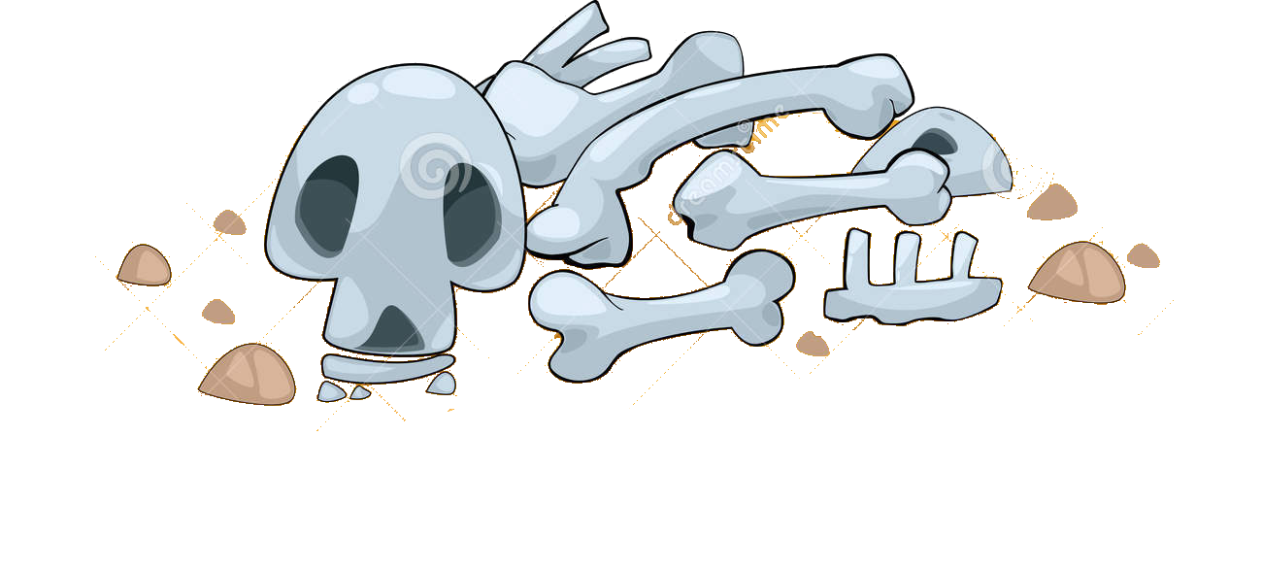
Cloud Native Adoption Curve
Entering at the wrong point in the continuum == failure
Red Hat Infrastructure Standard Adoption Model
RH-ISAM
Network
Automation
Secured Supply Chain
IaC
Builds
Multi-Cloud
Server Provisioning
Zero Trust
GitOps
CI/CD Scaffolding
Return on Investment
In-Place Upgrades
OpenShift
Enterprise Pipelines
Migration Factories
OpenShift + ACM + ACS
Developer
Workstations
Container Dev Environment
Entry Automation | Infra automation | Container Development | Container Platform Essentials | Workload Intake Acceleration | Platform Services | Advanced Capabilities | Regulatory Support
Time
Adapted From: Flight Path End to End by Adam Seeley and Bob Mader
Notes:
[Content Owner]: Paul Armstrong, Mike Savage
Adapted from Flight Path End to End by Adam Seeley and Bob Mader
This graph represents the RETURN ON INVESTMENT vs. TIME. THIS IS NOT “the hype curve” although it has a similar profile. It’s intent is to show the benefit to the organization w.r.t. getting the basic skill for their organization done well.
There is huge value.
The other aspect is to show where the customer will likely fail.
Through the many deployments that the Flight Path team have fixed, they have seen that if you start in the wrong place on the continuum, you end up in the bone-yard.
Don’t push too fast.

Slide 12
Combining Flight Path with the Curve
Build-up of RHEL, Ansible and OpenShift platform capabilities that are used to accelerate application adoption.
Red Hat Infrastructure Standard Adoption Model
RH-ISAM
Network
Automation
Secured Supply Chain
Prod-like Sandbox
IaC
Builds
Security patching
Multi-Cloud
Server Provisioning
Product upgrades
Zero Trust
Dynamic scaling
GitOps
CI/CD Scaffolding
Return on Investment
Ephemeral environment
In-Place Upgrades
Container Dev Environment
OpenShift
Automated deployments
Developer
Workstations
Enterprise grade environment
Configuration Management
Configuration
Non-Production
Lifecycle Management
GitOps
Production Environments
Self Service
Scale
Entry Automation | Infra automation | Container Development | Container Platform Essentials | Workload Intake Acceleration | Platform Services | Advanced Capabilities | Regulatory Support
Time
Adapted From: Flight Path End to End by Adam Seeley and Bob Mader
Notes:
[Content Owner]: Paul Armstrong, Mike Savage
Adapted from Flight Path End to End by Adam Seeley and Bob Mader
This graph represents the RETURN ON INVESTMENT vs. TIME. THIS IS NOT “the hype curve” although it has a similar profile. It’s intent is to show the benefit to the organization w.r.t. getting the basic skill for their organization done well.
There is huge value.
The other aspect is to show where the customer will likely fail.
Through the many deployments that the Flight Path team have fixed, they have seen that if you start in the wrong place on the continuum, you end up in the bone-yard.
Don’t push too fast.
It layers on top the advantage of timing the deployment of OpenShift environments and adoption.
You smooth the overall ROI experienced by the customer. In our experience, customer success rate increases. ROI is continuous.

Slide 13
Red Hat Infrastructure Standard Adoption Model
A modular framework to support customer infrastructure modernisation - click on components for more information
Red Hat Infrastructure Standard Adoption Model
Migrate to RHEL
Analysing workloads on non-RHEL platforms (inc. legacy UNIX, Windows, +Linux), creating a migration strategy, replatforming candidate workloads on RHEL using a migration factory approach.
Convert to RHEL
Analysing and converting in-place rpm based operating systems to RHEL.
This allows in-place upgrade to eliminate technical debt.
Upgrade to RHEL8 or 9
Analysis and in-place upgrading servers running older versions of RHEL to RHEL8 or RHEL9.
Modernize Virtualization
Deploy New Virtualization Platforms and migrate workloads onto it.
Modernize Application Delivery
Analysis and migration of applications running any operating system to a standard methodology
Deliver All Standard Workloads through Automation
Plugable Solutions
at least one + Contribute
Implement the Red Hat Infrastructure Standard Platform *
Required :building a secure, stable, manageable, automated RHEL platform to scale workloads on
Foundational
Navigate to the Red Hat Infrastructure Standard
Engage with Red Hat to fully determine requirements, operational readiness.
Infographic 3: The how the Red Hat Infrastructure Standard enables Red Hat Services delivery moving and cross selling motions
* This component is mandatory unless the customer already has a RHEL Standard Operating Environment in place.
Notes:
[Content Owner: Martijn Ten Heuvel and Paul Armstrong]
List:
Migrate to RHEL document
Convert to RHEL document
Upgrade to RHEL9 document (DONE)
Migration pilot for OSP (openstack) - does that still have a value?
Add a new box: migrate to OCP virtualization, find the virtualization approach build.
Same with HANA
SOE Provisioning also is a link.

Slide 14
Discovery
Why is this important?
Who will be responsible?
Who will be involved in execution?
What is the task we need to execute?
What are target applications?
Pilot
To Be
Create and build modernisation paths
Deploy automation tools
Design and deploy SOE
Test modernisation of workloads Use side by side comparisons, use dark launches, test deployments
Define the factory
Define day 2 operations and other standards
Automate everything
Navigate
Operationalize
Review the current environment and integrations, dependencies
Review applications and review systems running these applications, identify and commit to the order of migrations
Analyse where these applications can go to: RHEL, containers, bin, and so on.
High level design for the new RHEL environment, including security model based on HBAC and RBAC and central directory services
Common understanding of the task at hand
Deploy the modernisation factory
Plan for modernisation
Modernize remaining systems
Implement responsibilities
Refactor and extend automation
As is
Notes:
We use a journeymap to identify where we are and where need to go. We are in the discovery phase today, ready to move to the navigate phase.
Discovery for us is to identify why and who, whereas during the Navigate we determine the how.
Once we have an idea on the how, we can start a pilot phase, where we start to create and build the modernisation paths, deploy the platform and tools and so on.

Slide 15








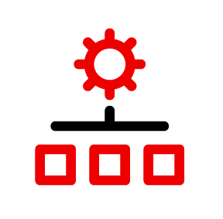



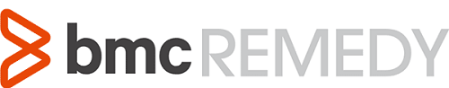

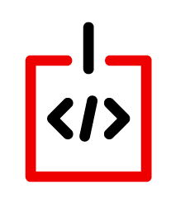






RH-ISAM in a Hybrid Cloud Deployment
Red Hat Infrastructure Standard Adoption Model
Red Hat Infrastructure Standard
Common Code and Process Across All Environments
Red Hat Hybrid Cloud
Services
Security/SSO
Lifecycle
Automation
Compliance
Configuration
Native AD Trust
Data Center 1
Data Center 2
Cloud 1
Region 1
Cloud 1
Region 2
Cloud 2
Cloud 3
Notes:
[Content Owner]: Paul Armstrong, Mike Savage
Abstracting Differences in the various data centers and cloud delivers Consistent Process and Reduces the impact of Change.
Automation can define processes to deliver content; define and deploy systems; check compliance and manage configuration; all by simply changing the variable values and not the underlying code.
As an example, using image builder we can define a cloud image from RHEL8 built from a Satellite content view. We can deploy that to AWS, Azure, VMware or OpenStack based simply on specifying the target connection information. We can then have Satellite deploy the image, again, by simply specifying the Compute Resource. Ansible can manage the host configuration no matter where it resides. When the image is deployed and configured for IdM integration, all the centralized policy is implemented on the system, again simply and easily.

Slide 16
Navigate workshops
Red Hat Infrastructure Standard Adoption Model
Adopting the Red Hat Infrastructure Standard
Notes:
[Content Owner: Martijn Ten Heuvel]

Slide 17
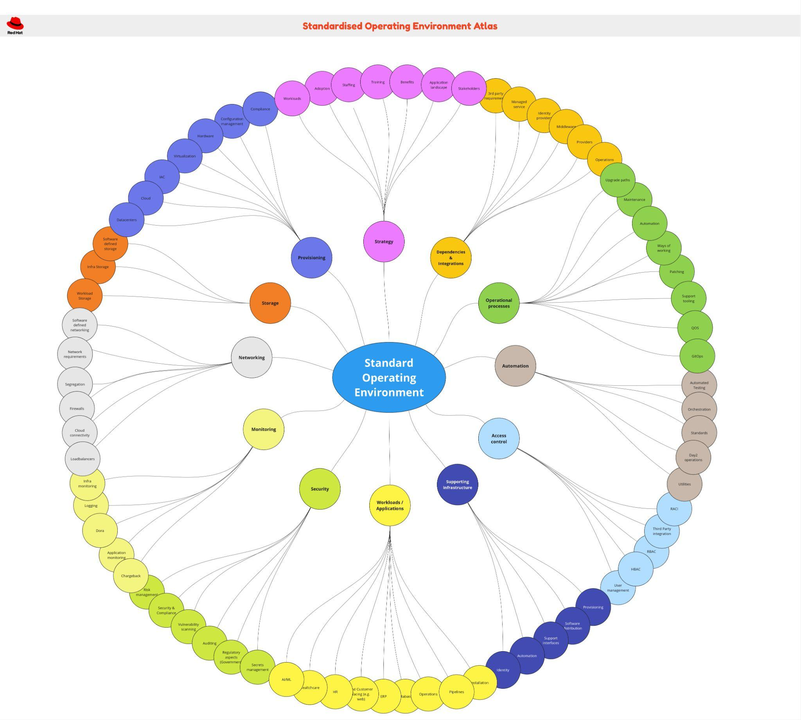
Red Hat IS Navigate - Atlas Overview
Atlas
Clear view about focus points classified by areas of influence:
Strategy
Workloads
Dependencies
Operational Processes
Automation
Access Control
Security
Monitoring
Networking
Supporting infrastructure
Provisioning
Objective: Ensure the coverage of key topics and discussions points that will be covered in the Analyse workshops.
Topics assist with steering the design consideration areas.
Notes:
[Content Owner: Martijn Ten Heuvel]
An SOE is not something standalone. These different focus areas here provide different angles we can/should discuss. Each off these have SMEs within HSE. These SMEs know how this works, we want to bring this knowledge together.
Analyse would align this, but we are not doing that. Therefor we have a day to connect to all these stakeholders so we can reach out and align.

Slide 18
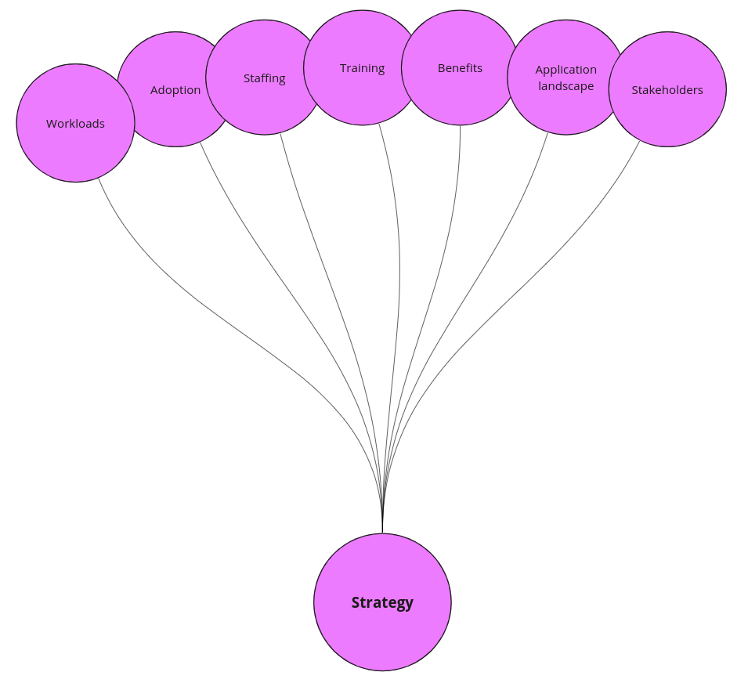
Red Hat IS Navigate - Workshops
Kick off & Strategy
Topics to cover (example):
Navigate Introduction
Customer Strategy
Workloads
Adoption
Benefits
Application Landscape
Personas:
Business Sponsors
Enterprise Architects
Platform Architects
Network Architects
Security Architects
Application Architects / SMEs
Product Owners
(Senior) Engineers/SysAdmin
Notes:
[Content Owner: Martijn Ten Heuvel]
Personas is the initial idea.

Slide 19
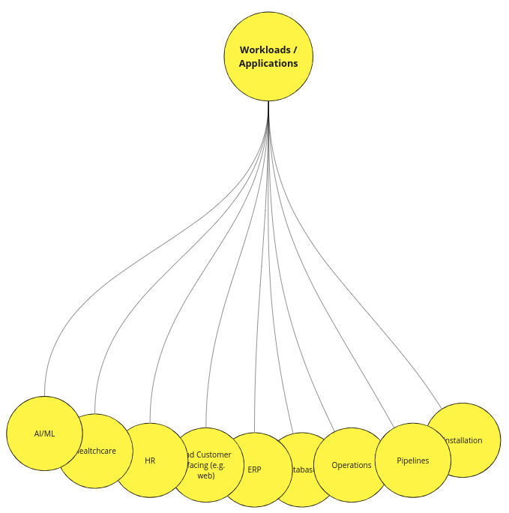
Red Hat IS Navigate - Workshops
Workloads
Topics to cover (example):
Workloads:
Type of applications
Pipelines
Installations
Databases
Operations
Automation
Personas:
Enterprise Architects
Platform Architects
Network Architects
Application Architects / SMEs
Product Owners
(Senior) Engineers/SysAdmin
Notes:
[Content Owner: Martijn Ten Heuvel]

Slide 20
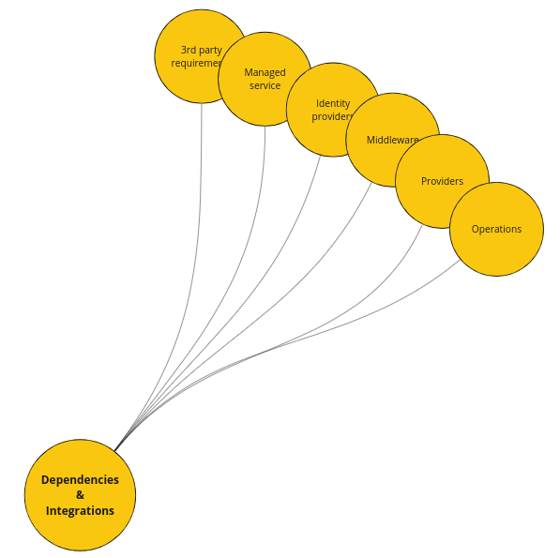
Red Hat IS Navigate - Workshops
Dependencies
Topics to cover (example):
Identification of 3-party applications
Identity Providers
Middleware
Managed Services
Personas:
Platform Architects
Network Architects
Security Architects
Application Architects / SMEs
Product Owners
(Senior) Engineers/SysAdmin
Notes:
[Content Owner: Martijn Ten Heuvel]

Slide 21
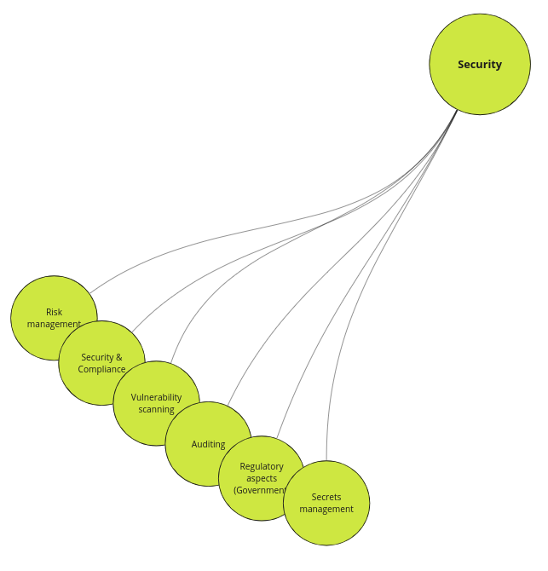
Red Hat IS Navigate - Workshops
Security
Topics to cover (example):
Security requirements:
Regulatory aspects
Compliance
Internal
Organization and teams
Auditing
Personas:
Enterprise Architects
Platform Architects
Network Architects
Security Architects
Application Architects / SMEs
Product Owners
(Senior) Engineers/SysAdmin
(Senior) Security Engineers
Notes:
[Content Owner: Martijn Ten Heuvel]

Slide 22
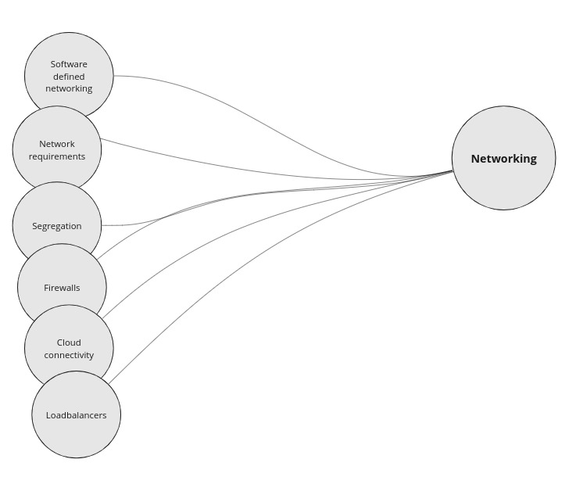
Red Hat IS Navigate - Workshops
Networking
Topics to cover (example):
Network Access
Software defined networking, e.g. ACI
Segregation and firewalls
Cloud connectivity
Personas:
Network Architects
Platform Architects
Application Architects / SMEs
Product Owners
(Senior) Engineers/SysAdmin
(Senior) Network Engineers
Notes:
[Content Owner: Martijn Ten Heuvel]

Slide 23
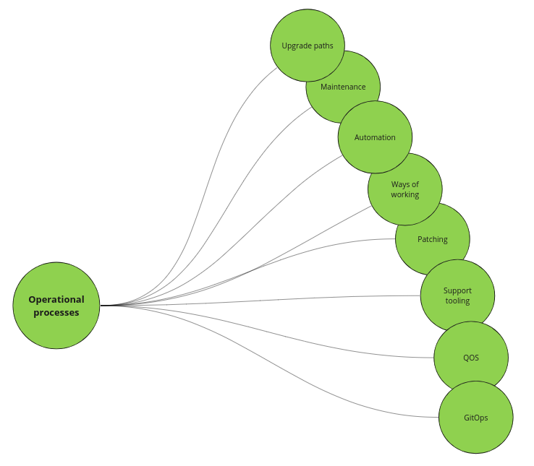
Red Hat IS Navigate - Workshops
Operational Processes
Topics to cover (example):
Maintenance
Ways of Working
Patching
Quality of Service
Personas:
Enterprise Architects
Platform Architects
Application Architects / SMEs
Product Owners
(Senior) Engineers/SysAdmin
Notes:
[Content Owner: Martijn Ten Heuvel]

Slide 24
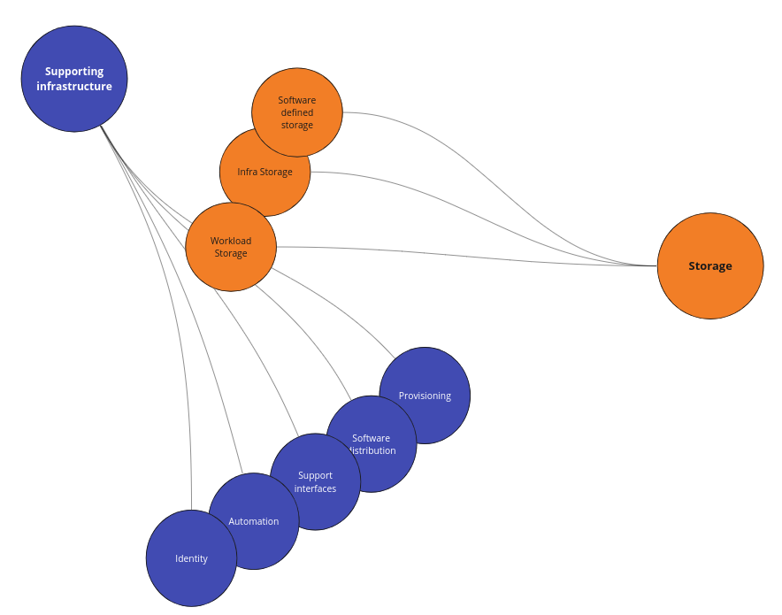
Red Hat IS Navigate - Workshops
Supporting infrastructure and storage
Topics to cover (example):
Storage Types
Storage Access
Software Defined Storage
Storage processes and management
Supporting infrastructure
Personas:
Platform Architects
Application Architects / SMEs
Product Owners
(Senior) Engineers/SysAdmin
(Senior) Storage Engineers
Notes:
[Content Owner: Martijn Ten Heuvel]

Slide 25
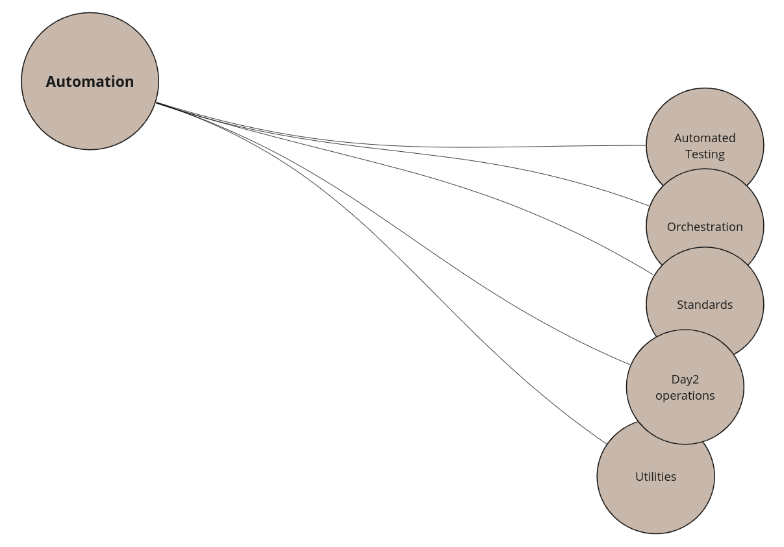
Red Hat IS Navigate - Workshops
Automation
Topics to cover (example):
Current tooling
Orchestration
Current standards
Toolset
Personas:
Enterprise Architects
Platform Architects
Application Architects / SMEs
Product Owners
(Senior) Engineers/SysAdmin
(Senior) Automation Engineers
Notes:
[Content Owner: Martijn Ten Heuvel]

Slide 26
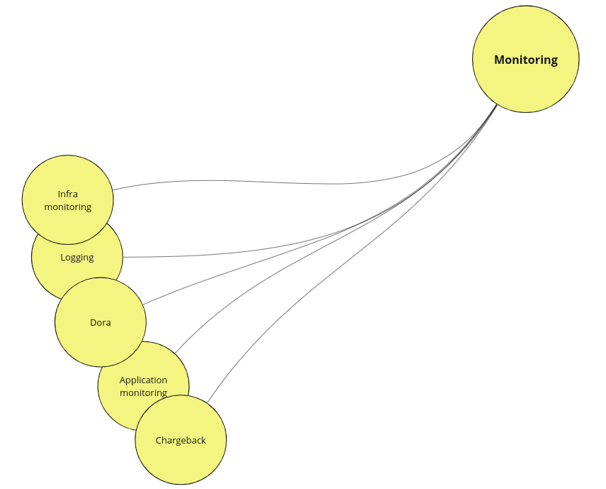
Red Hat IS Navigate - Workshops
Monitoring
Topics to cover (example):
Monitoring platform
Infrastructure monitoring
Application monitoring
Logging
Chargeback
Personas:
Platform Architects
Application Architects / SMEs
Product Owners
(Senior) Engineers/SysAdmin
(Senior) Monitoring Engineers
Notes:
[Content Owner: Martijn Ten Heuvel]

Slide 27
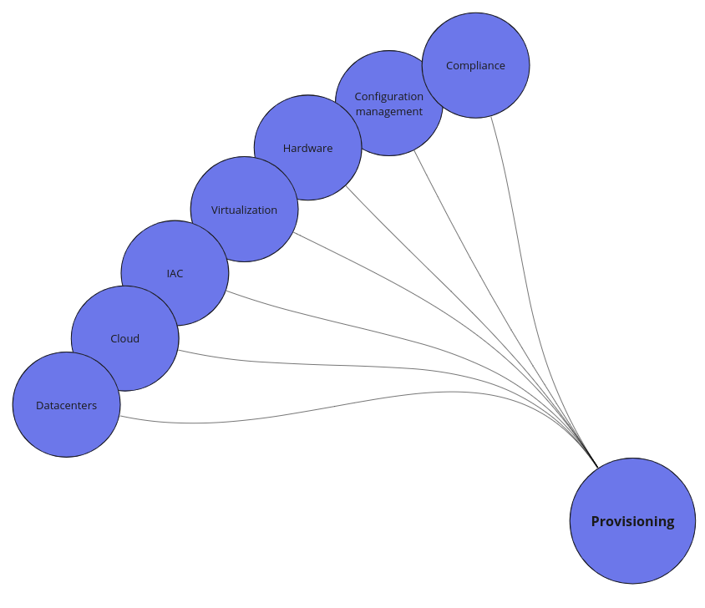
Red Hat IS Navigate - Workshops
Provisioning
Topics to cover (example):
Configuration management
Infrastructure as Code principals
Cloud, virtualization and hardware usage
Compliance
Personas:
Platform Architects
Application Architects / SMEs
Product Owners
(Senior) Engineers/SysAdmin
(Senior) Automation Engineers
Notes:
[Content Owner: Martijn Ten Heuvel]

Slide 28
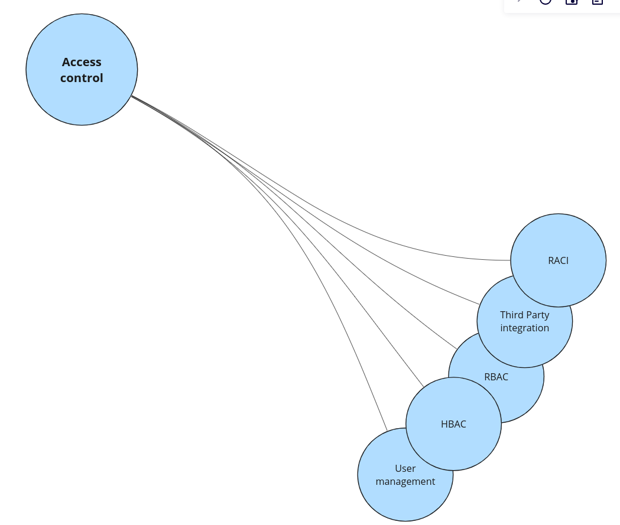
Red Hat IS Navigate - Workshops
Access control
Topics to cover (example):
Organization and teams
RBAC model
Integrations
Responsibilities and roles (RACI)
Authentication and authorisation
Personas:
Enterprise Architects
Platform Architects
Security Architects
Application Architects / SMEs
Product Owners
(Senior) Engineers/SysAdmin
(Senior) Security Engineers
Notes:
[Content Owner: Martijn Ten Heuvel]

Slide 29
Red Hat IS Navigate - Workshops
Wrap up & Next steps
Topics to cover (example):
Present outcomes
Delivery of report
Presentation of roadmap
Personas:
Business Sponsors
Enterprise Architects
Platform Architects
Network Architects
Security Architects
Application Architects / SMEs
Product Owners
(Senior) Engineers/SysAdmin
Notes:
[Content Owner: Martijn Ten Heuvel]

Slide 30
Thank you!
Red Hat is the world’s leading provider of enterprise open source software solutions. Award-winning support, training, and consulting services make
Red Hat a trusted adviser to the Fortune 500.
Notes:
[Content Owner]: Paul Armstrong

Slide 31
Contributing:
Editing - please add slides that you would like to see to the deck. If they need a section, add the section separator slide. Tag your slide in the content notes section with:
[Content Owner]: <Your Name>
This helps in collaborating with others. There are lots of editors :-)
You are responsible for maintaining your content in this deck. Please only edit your own content.
If you need to make changes for a customer presentation, please make a copy to your own drive.
Notes:
[Content Owner]: Paul Armstrong

Slide 32
Contributors and Reviewers
Red Hat Infrastructure Standard Adoption Model
The following people had a hand in contributing to and/or reviewing this content. *
Name | Email | Title + Org | Role
Martijn ten Heuvel | mtenheuv@redhat.com | Senior Architect - Solutions & Technology Practice | Contributor
Paul Armstrong | parmstro@redhat.com | Principal Technical Specialist - RoOT Canada | Contributor
Mike Savage | msavage@redhat.com | Chief Architect - CTO Org: Customer-led Open Innovation | Contributor
Jerone Young | jyoung@redhat.com | Senior Architect - Consulting Services | Contributor
Jelki Dijkstra | jdijkstr@redhat.com | Cloud Architect - Consulting Services | Contributor
with content adapted from FlightPath End to End by Adam Seely and Bob Mader
* Contributors and Reviewers - Please add your information and Role to the above table
Notes:
[Content Owner]: Paul Armstrong

Slide 33

Document version: CURRENT
Document Owner: Paul Armstrong <parmstro@redhat.com>
Current Recommended Version: This document
Content Owner: The user responsible for each slide’s content is marked in the speaker notes
See: Contributors page
This document follows the ABCD Versioning Notation Lifecycle

